Slide 1
Exceptional Control Flow: Exceptions and Processes Introduction to Computer Systems November 17th, 2016 By Jet （张孝帅）

Slide 2
Review
Exceptional Control Flow
Exceptions
Processes
Process Control

Slide 3
Control Flow
Processors do only one thing:
From startup to shutdown, a CPU simply reads and executes (interprets) a sequence of instructions, one at a time
This sequence is the CPU’s control flow (or flow of control)
Physical control flow
<startup> I₁ -> I₂ -> I₃ -> I₄ …… -> I_{n} <shutdown>
Timeline

Slide 4
Control Flow
Processors do only one thing:
From startup to shutdown, a CPU simply reads and executes (interprets) a sequence of instructions, one at a time
This sequence is the CPU’s control flow (or flow of control)
Up to now: two mechanisms for changing control flow:
Jumps and branches
Call and return
React to changes in program state
Physical control flow
<startup> I₁ -> I₂ -> I₃ -> I₄ …… -> I_{n} <shutdown>
Timeline

Slide 5
Control Flow
Insufficient for a useful system: Difficult to react to changes in system state
Invalid Instruction?
Data arrives from a disk or a network adapter?
Instruction divides by zero?
User hits Ctrl-C at the keyboard?
System timer expires?
System needs mechanisms for “exceptional control flow”

Slide 6
ECF Structure
C Library
(Application)
Nonlocal Jump
C setjump, longjump
C++, java try...catch...
Signal
Send Ctrl-C, SIGSEGV etc.
Kernel
(Operating System)
Exception
Interrupt, trap, fault, abort.
Low level.
Hardware
Notes:
（自底层（硬件）往上（操作系统、软件）的异常控制流，可以看到exception在最底层）
异常控制流存在于系统的每个层级，最底层的机制称为异常(Exception)，用以改变控制流以响应系统事件，通常是由硬件的操作系统共同实现的。更高层次的异常控制流包括进程切换(Process Context Switch)、信号(Signal)和非本地跳转(Nonlocal Jumps)，也可以看做是一个从硬件过渡到操作系统，再从操作系统过渡到语言库的过程。进程切换是由硬件计时器和操作系统共同实现的，而信号则只是操作系统层面的概念了，到了非本地跳转就已经是在 C 运行时库中实现的了。

Slide 7
Exceptional Control Flow
Exists at all levels of a computer system
Low level mechanisms
Exceptions
Change in control flow in response to a system event (i.e., change in system state)
Implemented using combination of hardware and OS software
Higher level mechanisms
Process context switch: Implemented by OS software and hardware timer
Signals: Implemented by OS software
Nonlocal jumps: Implemented by C runtime library

Slide 8
Review
Exceptional Control Flow
Exceptions
Processes
Process Control

Slide 9
Exceptions
An exception is a transfer of control to the OS kernel in response to some event (i.e., change in processor state)
Kernel is the memory-resident part of the OS
Examples of events: Divide by 0, arithmetic overflow, page fault, I/O request completes, typing Ctrl-C
User code
Kernel code
Event
I_current
Exception
I_next
Exception processing
by exception handler
Return to I_current
Return to I_next
Abort
Notes:
事件可能由指令本身触发，也可能由外部条件改变触发（中断）。

Slide 10
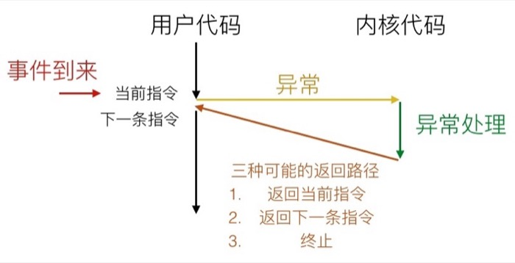
Notes:
（画在黑板上）

Slide 11
Exceptional Control Flow
Code for
exception handler 0
Exception
numbers
Exception
Table
Code for
exception handler 1
0
1
Code for
exception handler 2
2
...
n-1
...
Code for
exception handler n-1
Notes:
OS在启动时维护了异常表和异常表指针（存在一个特定的寄存器中）。每种异常有唯一确定的异常号，异常发生时，CPU确定异常号，并根据异常跳转表内容跳转到异常处理程序执行。

Slide 12
Exception Taxonomy (Partial)
ECF
Asynchronous
Synchronous
Interrupts
Traps
Faults
Aborts
Notes:
大体分为同步异常和异步异常两种。

Slide 13
Asynchronous Exceptions (Interrupts)
Caused by events external to the processor
Indicated by setting the processor’s interrupt pin
Handler returns to “next” instruction
Examples:
Timer interrupt
Used by the kernel to take back control from user programs
I/O interrupt from external device
Hitting Ctrl-C at the keyboard
Arrival of data from a disk
Notes:
中断由CPU的中断引脚触发，常是IO原因。Timer用于实现上下文切换（多线程）。

Slide 14
Synchronous Exceptions
Caused by events that occur as a result of executing an instruction:
Traps: Intentional
Examples: system calls, breakpoint traps, special instructions
Returns control to “next” instruction
Faults: Unintentional but possibly recoverable
Examples: page faults (recoverable), protection faults (unrecoverable), floating point exceptions (unrecoverable on Unix)
Either re-executes faulting (“current”) instruction or aborts
Aborts: Unintentional and unrecoverable
Examples: illegal instruction, parity error, machine check
Aborts current program

Slide 15
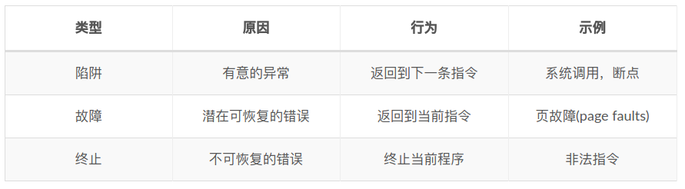
Synchronous Exceptions

Slide 16
System Calls
Exception number 0x80 (128 in decimal).
Each x86-64 system call has a unique ID number (different from IA32)
Examples:
Number | Name | Description
0 | read | Read file
1 | write | Write file
2 | open | Open file
3 | close | Close file
4 | stat | Get info about file
57 | fork | Create process
59 | execve | Execute a program
60 | _exit | Terminate process
62 | kill | Send signal to process
Notes:
要注意区分清楚异常号和系统调用号，系统调用的异常号是0x80。
（Linux下IA32的系统调用号和x86-64的不同）

Slide 17
System Call Example: Opening File
User calls: open(filename, options)
Calls __open function, which invokes system call instruction syscall
00000000000e5d70 <__open>:
...
e5d79: b8 02 00 00 00 mov $0x2,%eax # open is syscall #2
e5d7e: 0f 05 syscall # Return value in %rax
e5d80: 48 3d 01 f0 ff ff cmp $0xfffffffffffff001,%rax
...
e5dfa: c3 retq
%rax contains syscall number
Other arguments in %rdi, %rsi, %rdx, %r10, %r8, %r9
Return value in %rax
Negative value is an error corresponding to negative errno

Slide 18
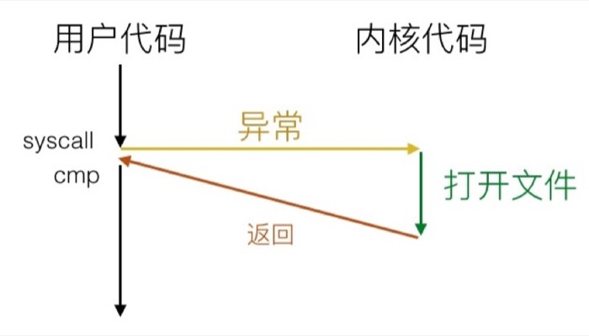
System Call Example: Opening File
User code
Kernel code
syscall
Exception
cmp
Open file
Returns
Notes:
系统调用类似函数调用：
1.都改变控制流
2.返回时执行下一条指令
3.类似的寄存器使用方式（传参，返回值）
重要区别：
1.函数代码是用户代码，而系统调用由内核处理
2.权限等级不同
3.函数地址 vs 系统调用号

Slide 19
Fault Examples
int a[1000];
main ()
{
a[500] = 13;
}
User code
Kernel code
Exception: page fault
movl
Copy page from disk to memory
Return and re-execute movl
Notes:
Maybe a general protection fault.（访问内核内存）

Slide 20
Fault Examples
int a[1000];
main ()
{
a[5000] = 13;
}
int a[1000];
main ()
{
a[500] = 13;
}
User code
Kernel code
Exception
movl
Detect invalid address
User code
Kernel code
Signal process
Exception: page fault
On Unix:
Sends SIGSEGV signal to user process
User process exits with “segmentation fault”
On Windows:
End process with problem reporting window.
movl
Copy page from disk to memory
Return and re-execute movl
Notes:
Maybe a general protection fault.（访问内核内存）

Slide 21
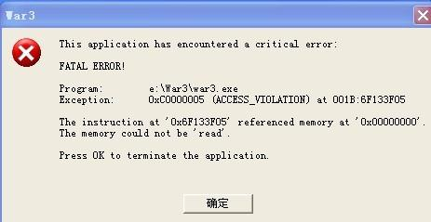
Fault Examples on Windows
Notes:
Maybe a general protection fault.（访问内核内存）

Slide 22
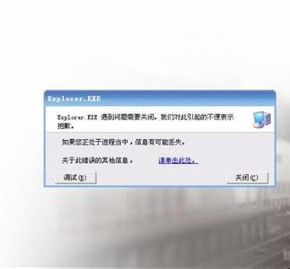
Fault Examples on Windows
Notes:
Maybe a general protection fault.（访问内核内存）

Slide 23
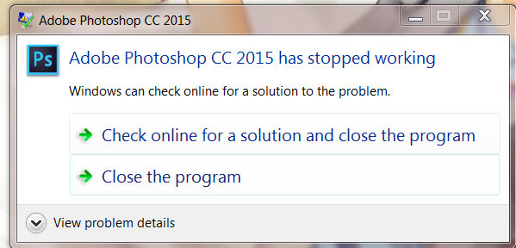
Fault Examples on Windows
Notes:
Maybe a general protection fault.（访问内核内存）

Slide 24
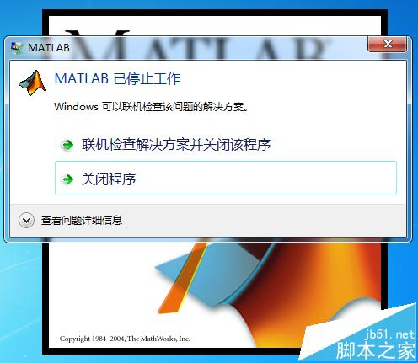
Fault Examples on Windows
Notes:
Maybe a general protection fault.（访问内核内存）

Slide 25
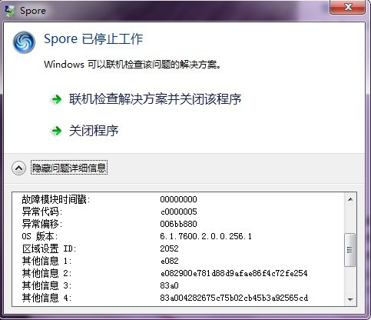
Fault Examples on Windows
Notes:
Maybe a general protection fault.（访问内核内存）

Slide 26
Floating Point Exception
Will this cause a floating point exception?
#include <stdio.h>
int main()
{
printf("%f", 1.0f / 0);
}

Slide 27
Floating Point Exception
#include <stdio.h>
int main()
{
printf("%d", 0 / 0);
}
Notes:
To see interrupts since upstart: cat /proc/inter

Slide 28
Review
Exceptional Control Flow
Exceptions
Processes
Process Control

Slide 29
Processes
Definition: A process is an instance of a running program.
One of the most profound ideas in computer science
Process provides each program with two key abstractions:
Logical control flow
Each program seems to have exclusive use of the CPU
Provided by kernel mechanism called context switching
Private address space
Each program seems to have exclusive use of main memory.
Provided by kernel mechanism called virtual memory
Memory
Stack
Heap
Data
Code
CPU
Registers
Notes:
进程是计算机科学中最重要的抽象概念之一，进程机制使得每个程序运行时认为自己独占CPU、独占内存（操作系统提供的抽象，通过上下文切换、虚拟内存等机制来实现）。
进程是操作系统进行资源分配的基本单位（内存资源，就线程来说）。

Slide 30
Multiprocessing
Fact: computer runs many processes simultaneously
Applications for one or more users
Web browsers, email clients, editors, …
Background tasks
Monitoring network & I/O devices
Processes are identified by a unique PID
To view all your running processes
top / htop etc.
ps -e
Notes:
Show htop

Slide 31
Multiprocessing: The Reality
Memory
Stack
Stack
Stack
Heap
Heap
…
Heap
Data
Data
Data
Code
Code
Code
Saved registers
Saved registers
Saved registers
CPU
Registers
Notes:
Single processor executes multiple processes concurrently
Process executions interleaved (multitasking)
Address spaces managed by virtual memory system (later in course)
Register values for nonexecuting processes saved in memory

Slide 32
Multiprocessing: The Reality
Memory
Stack
Stack
Stack
Heap
Heap
…
Heap
Data
Data
Data
Code
Code
Code
Saved registers
Saved registers
Saved registers
CPU
Registers
Notes:
Single processor executes multiple processes concurrently
Process executions interleaved (multitasking)
Address spaces managed by virtual memory system (later in course)
Register values for nonexecuting processes saved in memory

Slide 33
Multiprocessing: The Reality
Memory
Stack
Stack
Stack
Heap
Heap
…
Heap
Data
Data
Data
Code
Code
Code
Saved registers
Saved registers
Saved registers
CPU
Registers
Notes:
Single processor executes multiple processes concurrently
Process executions interleaved (multitasking)
Address spaces managed by virtual memory system (later in course)
Register values for nonexecuting processes saved in memory

Slide 34
Multiprocessing: The Reality
Memory
Stack
Stack
Stack
Heap
Heap
…
Heap
Data
Data
Data
Code
Code
Code
Saved registers
Saved registers
Saved registers
CPU
Registers
Notes:
Single processor executes multiple processes concurrently
Process executions interleaved (multitasking)
Address spaces managed by virtual memory system (later in course)
Register values for nonexecuting processes saved in memory

Slide 35
Multiprocessing: The Reality (Multicore)
Memory
Stack
Stack
Stack
Heap
Heap
…
Heap
Data
Data
Data
Code
Code
Code
Saved registers
Saved registers
Saved registers
CPU 0
CPU 1
Registers
Registers
Notes:
Multicore processors
Multiple CPUs on single chip
Share main memory (and some caches)
Each can execute a separate process
Scheduling of processors onto cores done by kernel

Slide 36
Concurrent Processes
Each process is a logical control flow.
Two processes run concurrently (are concurrent) if their flows overlap in time
Otherwise, they are sequential
Examples (running on single core):
Concurrent: A & B, A & C
Sequential: B & C
Process A
Process B
Process C
Time
Notes:
A、B，A、C是并发执行的，而B、C是顺序执行的。（不知道会不会考？）
要注意，并发执行不等于并行(concurrent, parallel)。
你吃饭吃到一半，电话来了，你一直到吃完了以后才去接，这是顺序执行。
你吃饭吃到一半，电话来了，你停了下来接了电话，接完后继续吃饭，这是并发。
你吃饭吃到一半，电话来了，你一边打电话一边吃饭，这是并行。
并发的关键是你有处理多个任务的能力，不一定要同时。
并行的关键是你有同时处理多个任务的能力。

Slide 37
Context Switching
Processes are managed by a shared chunk of memory-resident OS code called the kernel
Important: the kernel is not a separate process, but rather runs as part of some existing process.
Control flow passes from one process to another via a context switch
Process A
Process B
user code
kernel code
context switch
Time
user code
kernel code
context switch
user code

Slide 38
Review
Exceptional Control Flow
Exceptions
Processes
Process Control

Slide 39
Process States
Generally there’re three states of a process (From a programmer’s perspective):
Running
Process is either executing, or waiting to be executed and will eventually be scheduled (i.e., chosen to execute) by the kernel
Stopped
Process execution is suspended and will not be scheduled until further notice (next lecture when we study signals)
Terminated
Process is stopped permanently
Notes:
Running: 正在执行或将要被系统执行（会被调度的进程）
Stopped: stopped by Ctrl-Z (SIGSTOP), continues when receiving SIGCONT（不会被系统调度）
Terminated: 收到终止信号，从main return，执行exit

Slide 40
Process States
Actual Process States can be one of:
D = uninterruptible sleep
R = running
S = sleeping
T = stopped by job control signal
t = stopped by debugger during trace
Z = zombie

Slide 41
C Process Handling Functions
pid_t getpid(void)
Returns PID of current process
pid_t getppid(void)
Returns PID of parent process
void exit(int status)
Terminates with an exit status of status
Convention: normal return status is 0, nonzero on error
Notes:
要注意，正常情况下，exit函数是不返回的，同时其被定义为void函数。

Slide 42
C Process Handling Functions
int fork(void)
Parent process creates a new running child process
int wait(int *child_status)
Suspends current process until one of its children terminates
pid_t waitpid(pid_t pid, int *status, int options)
Suspends current process until specific process terminates
int execve(char *filename, char *argv[], char *envp[])
Loads and runs a program in the current process.
Notes:
所有这些C函数都是借助系统调用实现的。

Slide 43
System Call Error Handling
On error, Linux system-level functions typically return -1 and set global variable errno to indicate cause.
Hard and fast rule:
You must check the return status of every system-level function
Only exception is the handful of functions that return void
Example:
if ((pid = fork()) < 0)
{
fprintf(stderr, "fork error: %s\n", strerror(errno));
exit(-1);
}
Notes:
错误时，Unix系统一般返回-1，并设置全局变量errno来指明错误原因。
如果程序员每次系统调用都这样检查是否出现错误，会使代码变得臃肿且不易读，我们可以对系统函数进行包装。
（注意exit也会触发系统调用）

Slide 44
Creating Processes
int fork(void)
Returns 0 to the child process, child’s PID to parent process
Child is almost identical to parent:
Child get an identical (but separate) copy of the parent’s virtual address space.
Child gets identical copies of the parent’s open file descriptors
Child has a different PID than the parent
fork is called once but returns twice
Problem: does fork return to child first, or to parent?
Solution: Create custom version of library routine that inserts random delays along different branches, then use runtime interpositioning to have program use special version of library code.

Slide 45
Fork Examples
Fork.h
0.fork.c
Try cFork, pFork, randFork
1.intro.c
Duplicate but separate address spaces
2.fork-print.c
Output buffer is duplicated
3.fork-graph.c
Draw process calling graph (Parent bash, systemd)
Show usage of htop

Slide 46
Fork Examples
4.fork-problem1.c
Application of former graph
5.fork-problem2.c
“Loop-unrolling”
“Function-expanding”
What if printf is in the loop?
What if printf first?

Slide 47
Reaping Child Processes
Idea
When process terminates, it still keep some information eg. Exit status, various OS tables
Called a “zombie”
Reaping
Performed by parent on terminated child (using wait or waitpid)
Parent is given exit status information
Kernel then deletes zombie child process
If any parent terminates without reaping a child, then the orphaned child will be reaped by init process (pid == 1)
So, only need explicit reaping in long-running processes
e.g., shells and servers
Notes:
(Also cosume some system resources)

Slide 48
Zombie Examples
0.zombie1.c
Defunct child will be reaped by systemd if not reaped by Parent
ps –aef | grep defunct
pstree
1.zombie2.c
Must be killed explicitly or system resource exhausted

Slide 49
Synchronizing with Children
Parent reaps a child by calling the wait/waitpid function
int wait(int *child_status)
Suspends current process until one of its children terminates
Return value is the pid of the child process that terminated
If child_status != NULL, then the integer it points to will be set to a value that indicates reason the child terminated and the exit status:
Checked using macros defined in wait.h
WIFEXITED, WEXITSTATUS, WIFSIGNALED, WTERMSIG, WIFSTOPPED, WSTOPSIG, WIFCONTINUED
pid_t waitpid(pid_t pid, int *status, int options)
Suspends current process until specific process terminates
See textbook for detail
Notes:
waitpid的选项比较多杂，书上讲的比较详细，相关知识点只能靠记忆。

Slide 50
wait/waitpid Examples
0.wait1.c
1.wait2.c
2.waitpid.c

Slide 51
Loading and Running Programs
int execve(char *filename, char *argv[], char *envp[])
Loads and runs in the current process:
Executable file filename
With argument list argv
By convention argv[0]==filename
With environment variable list envp
“name=value” strings (e.g., USER=jet)
Retains PID, open files and signal context. Overwrites code, data, and stack.
exec function set include execve, execvp, execv, execl, execle.
Called once and never returns
Except if there is an error
Notes:
execve函数通过系统调用读入外部程序，覆盖当前进程的代码（指令）、数据及栈帧（保留PID、打开的文件等）和并执行。
先fork再execve相当于建立子进程并执行外部程序。

Slide 52
Null-terminated
environment variable strings
Bottom of stack
Structure of the stack when a new program starts
Null-terminated
command-line arg strings
envp[n] == NULL
envp[n-1]
environ
(global var)
...
envp[0]
argv[argc] = NULL
envp
(in %rdx)
argv[argc-1]
...
argv
(in %rsi)
argv[0]
argc
(in %rdi)
Stack frame for
libc_start_main
Top of stack
Future stack frame for
main
Notes:
由_start设置（7.9节7-14）

Slide 53
execve Example
Execute “/bin/ls –lt /usr/include” in child process using current environment and prepared arguments:
if ((pid = Fork()) == 0) { /* Child runs program */
if (execve(myargv[0], myargv, environ) < 0) {
printf("%s: Command not found.\n", myargv[0]);
exit(1);
}
}
envp[n] = NULL
envp[n-1]
"PWD=/usr/droh"
…
envp[0]
"USER=droh"
environ
myargv[argc] = NULL
(myargc == 3)
myargv[2]
"/usr/include"
myargv[1]
"-lt"
myargv
myargv[0]
"/bin/ls"
Notes:
在execve加载程序以后，调用7.9节的启动代码,启动代码设置用户栈。并将控制传递给新程序的主函数。

Slide 54
execve Examples
haha.c
stack-haha.c

